Slide 1
Informational Non-equilibrium concentration
Chung-Yun Hsieh¹, Benjamin Stratton¹, Hao-Cheng Weng¹, Valerio Scarani²
The University of Bristol.
Centre for Quantum Technologies, National University of Singapore.

Slide 2
Results Overview
We have calculated the an agent's ability to increase local purity given two copies of a pure states

Slide 3
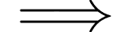
What is a resource?
Property of a quantum object that is useful
Resource of object A > Resource of object B
objects A’s performance > object’s B’s Performance
in some task
Notes:
Physically we are thinking about objects having value (being useful) with respect to some set of physical constraints, this allows us to mathematically quantify them

Slide 4

What is a resource?
Resource Theory
Allowed Operations
Resource Quantifiers
Operational Interpretations
Free States
Rigorously mathematical framework to define the notion of “usefulness”
Quantum resource theories, Reviews of Modern Physics, Eric Chitambar, Gilad Gour

Slide 5
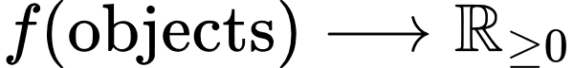
Resource Quantifiers
We can quantify the resource content of an object via some real valued function:
objects A’s performance > object’s B’s Performance
in a task

Slide 6
Resource Enhancement
There is an incentive to increase the amount of resource one has
Typically, this has been studied under the framework of resource distillation
Several copies of a less resourceful state are converted into fewer copies of a more resourceful state

Slide 7
Resource Enhancement
There is an incentive to increase the amount of resource one has
Typically, this has been studied under the framework of resource distillation
Several copies of a less resourceful state are converted into fewer copies of a more resourceful state

Slide 8
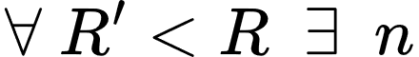
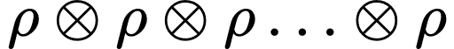
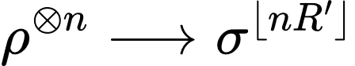
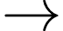
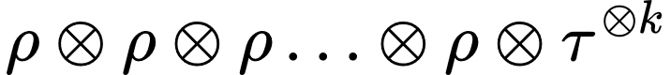
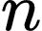
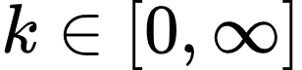
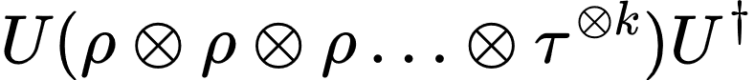
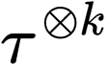
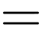
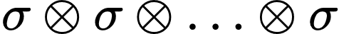
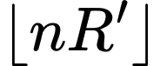
Resource Distillation
such that
Allowed operation
Free States

Slide 9
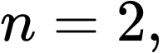
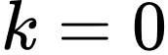
Resource Distillation
What about resource enhancement in the opposite limit?

Slide 10
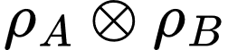
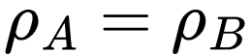
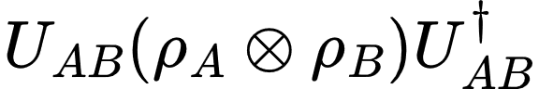
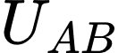
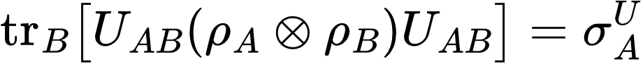

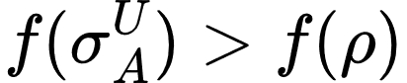
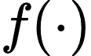
Resource Concentration
Where is a resource non-increasing unitary
is a resource quantifier (a monotone)

Slide 11
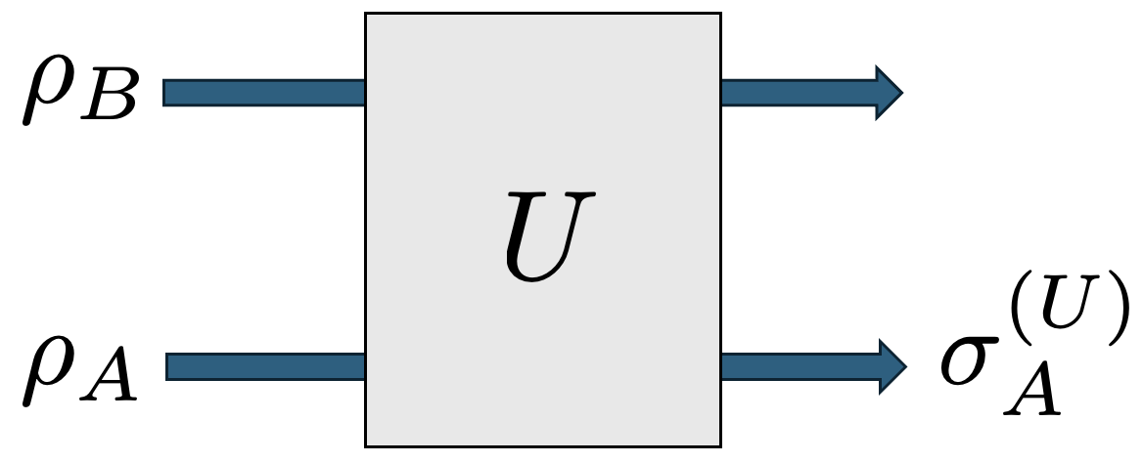
Resource Concentration
Resource non-increasing

Slide 12
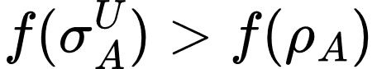
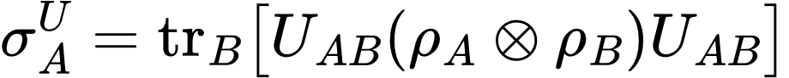
Resource Concentration
Does there exists a two-qudit, resource non-increasing unitary, , achieving
where

Slide 13
Resource Concentration
Why are we interested in such a paradigm?
Smallest means more practically feasible
We can try and perform complete accounting of informational changes
What happened to the “junk”?
Can we try determine the dynamics for resource enhancement

Slide 14
In this work, we considered concentration in the resource theory of informational non-equilibrium.
The resource theory of informational nonequilibrium in thermodynamics, Gour et al., Physics Reports, 2015

Slide 15
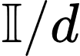
Informational Non-equilibrium
Colloquially: the resource (informational non-equilibrium) of a state is a measure of how “far” that state is from the maximally mixed state (the informational equilibrium state)
Allowed Operations Free States
Noisy Operations Maximally mixed state
We care about the subset of allowed operations that are unitary
Notes:
Noisy operations are a strict subset of unital operations. But there exists a noisy operation between two states if and only if there also exists a unital operation between them too.

Slide 16
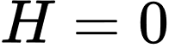
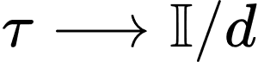
Informational Non-equilibrium
Special case of the resource theory of thermodynamics
Allows the informational contributions to thermodynamics to be isolated from the energetic ones.
Mathematical simple and hence a good test bed for new ideas.
such that
Notes:
Noisy operations are a strict subset of unital operations. But there exists a noisy operation between two states if and only if there also exists a unital operation between them too.

Slide 17
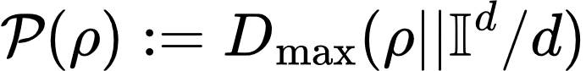
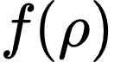
Measuring Informational Non-equilibrium
(our )
d-dimensional maximally mixed state
Notes:
Noisy operations are a strict subset of unital operations. But there exists a noisy operation between two states if and only if there also exists a unital operation between them too.

Slide 18
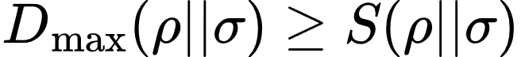
Measuring Informational Non-equilibrium
Mathematical Properties
Notes:
Noisy operations are a strict subset of unital operations. But there exists a noisy operation between two states if and only if there also exists a unital operation between them too.

Slide 19
Measuring Informational Non-equilibrium
This is a good measure of informational non-equilibrium
Monotonic under allowed operations:
Faithful:
i.e is a free state (here we have only one free state)
Notes:
Noisy operations are a strict subset of unital operations. But there exists a noisy operation between two states if and only if there also exists a unital operation between them too.

Slide 20
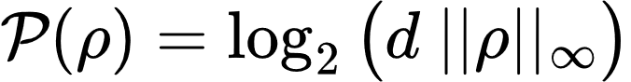
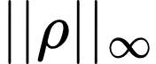
Measuring Informational Non-equilibrium
- Maximum Eigenvalue
Notes:
Noisy operations are a strict subset of unital operations. But there exists a noisy operation between two states if and only if there also exists a unital operation between them too.

Slide 21
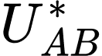
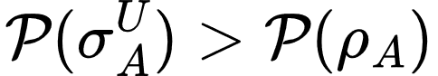
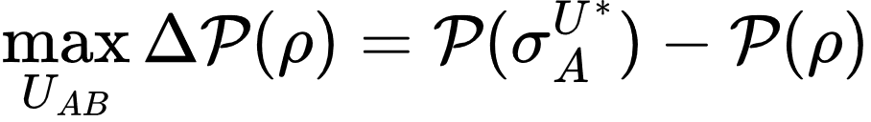
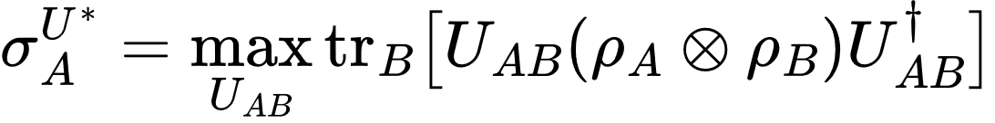
Informational Non-equilibrium Concentration
Does there exists a two-qudit unitary, , achieving
All are resource non-increasing when considering informational non-equilibrium
where
Notes:
Noisy operations are a strict subset of unital operations. But there exists a noisy operation between two states if and only if there also exists a unital operation between them too.

Slide 22
Main Results

Slide 23
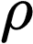
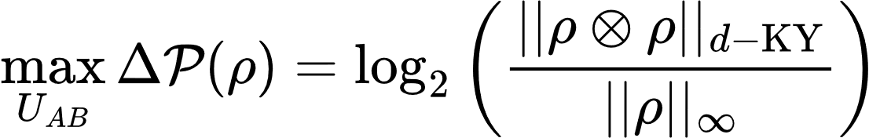
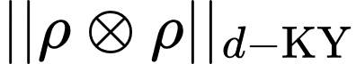
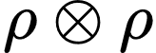
Main Result
For a d-dimensional state ,
Where
- The sum over the d largest eigenvalues of

Slide 24
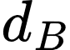
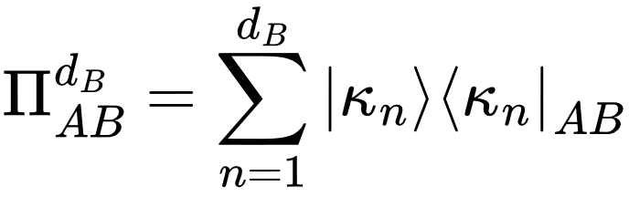
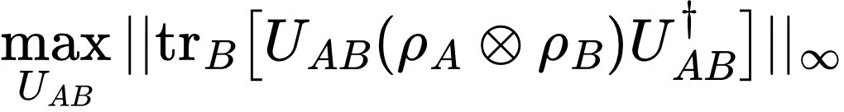
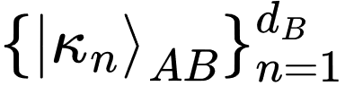
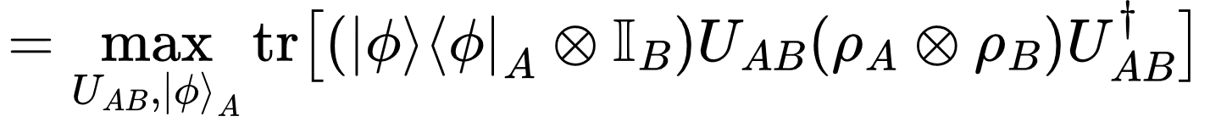
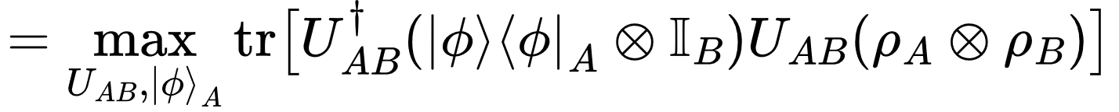
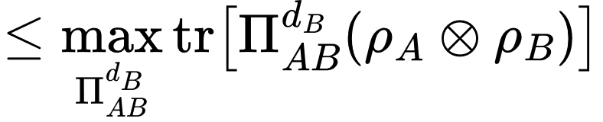
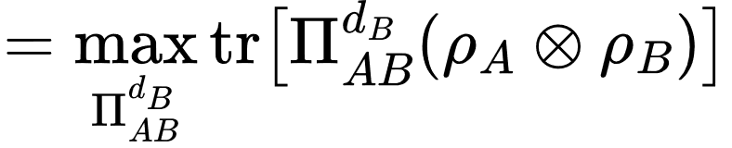
Proof Sketch
Arbitrary rank projector
- dimensional projector
This is maximised by projecting on the largest eigenvalues.
This is captured by the KY-Fan norm.

Slide 25



Initial Takeaways
This is true for all resource measures
No concentration for two qubits:
For all , one can always find a such that
Concentration is bounded by initial resource content:
Notes:
Unique to qubits that informational non-equilibrium concentration is not possible. Need to understand why true for all metrics

Slide 26
A notion of “Bound” Informational Non-equilibrium

Slide 27


A notion of “Bound” Informational Non-equilibrium
If , then .
If is not a pure state, and not the maximally mixed state, but the above is satisfied, then,
is resourceful but that resource cannot be concentrated.
We coin the term bound informational non-equilibrium to describe such states

Slide 28


A notion of “Bound” Informational Non-equilibrium
All non-pure, not maximally mixed qubits have bound-informational non-equilibrium.
All states with $\left(d−1\right)$-fold degeneracy in their eigen-spectrum have bound informational non-equilibrium
Some pure state

Slide 29


A notion of “Bound” Informational Non-equilibrium
All non-pure, not maximally mixed, qubits have bound-informational non-equilibrium.
All states with $\left(d−1\right)$-fold degeneracy in their eigen-spectrum have bound informational non-equilibrium
Dephasing channels acting on pure states produce states with bound informational non-equilibrium

Slide 30
A notion of “Bound” Informational Non-equilibrium
All non-pure, not maximally mixed, qubits have bound-informational non-equilibrium.
All states with $\left(d−1\right)$-fold degeneracy in their eigen-spectrum have bound informational non-equilibrium
Open question: do there exists other states that have bound informational non-equilibrium?

Slide 31
Qutrit Example

Slide 32




Qutrits
As
The optimal amount of informational non-equilibrium that be concentrated given two qutrits is always given by the above equation

Slide 33

Qutrits
Always the max three eigenvalues
As
The optimal amount of informational non-equilibrium that be concentrated* given two qutrits is always given by the above equation
*with respect to the chosen resource measure

Slide 34
Qutrits
Let
(applied on )
The dynamics that optimally concentrate informational non-equilibrium* given two qutrits is independent of the eigenvalues of the state

Slide 35
Qutrits
(applied on )
The dynamics that optimally concentrate informational non-equilibrium given two qutrits is independent of the state

Slide 36


Qutrits
System A’s local change in resource
Symmetric due to the ordering of the eigenvalues
States with bound informational non-equilibrium
Maximum Concentration for states where:

Slide 37


Qutrits
Max change
Zero change

Slide 38

Qutrits

Slide 39

Qutrits

Slide 40



Qutrits
,
Two-qutrit optimal concentration must generate global correlation:

Slide 41
Conclusion

Slide 42
Future Directions
Apply this framework to other static resources
Athermaility, Unspeakable Coherence, Entanglement
Do there exists other states with bound informational non-equilibrium?
Explore the notion of concentration of non-static resources
Measurement, dynamics.

Slide 43

Thank you
Informational non-equilibrium concentration,
Chung-Yun Hsieh, Benjamin Stratton, Hao-Cheng Weng, Valerio Scarani
arXiv.2409.12759

Slide 44
Correlations, Entanglement and Concentration

Slide 45




Correlations and Concentration
Can correlations activate concentration?
Maximally entangled state over AB
Let have bound informational non-equilibrium.
Global correlations can active concentration, and bound informational non-equilibrium is not robust to noise
, if applied
Change in in system A

Slide 46

Entanglement and Concentration
What about entanglement?
What can I concentrate with:
of pure state
of initial marginal
Vs what I concentrate with:

Slide 47
Entanglement and Concentration
What about entanglement?
What can I concentrate with:
Vs what I concentrate with:
Entanglement Advantage

Slide 48
Informational Non-equilibrium vs Purity
Purity
The physical property about whether the system in a pure state
Informational non-equilibrium
The physical property about whether the system not in the maximally mixed state
Dimension independent
Dimension dependent
Notes:
Noisy operations are a strict subset of unital operations. But there exists a noisy operation between two states if and only if there also exists a unital operation between them too.

Slide 49



Informational Non-equilibrium vs Purity
Notes:
Noisy operations are a strict subset of unital operations. But there exists a noisy operation between two states if and only if there also exists a unital operation between them too.

